Slide 2
The game brief
Based on the 1980’s Warlords Atari 2600 game.
For a 12 year old child to play.
The client yearns for the days of when he used to play computer games against his neighbourhood friends.
Players move a paddle to deflect the ball and protect their warlord.
Each warlord protected by a barrier of walls.

Slide 3
Our game
Brings the graphics and sounds up to a modern standard.
Maintains the core elements of the original game.
Adds extra features to make the game more difficult/ enjoyable
Follows a theme through the ages:
Neolithic
Medieval
Industrial
Space

Slide 4
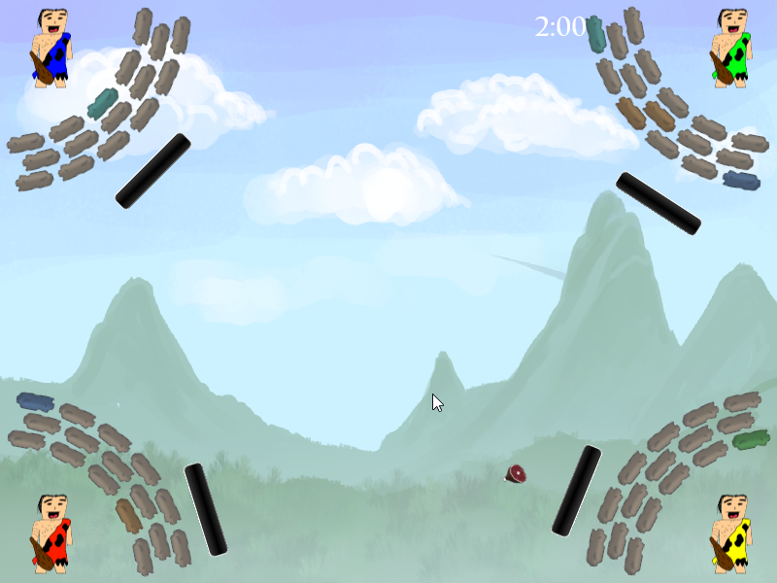
The Game - Neolithic

Slide 5
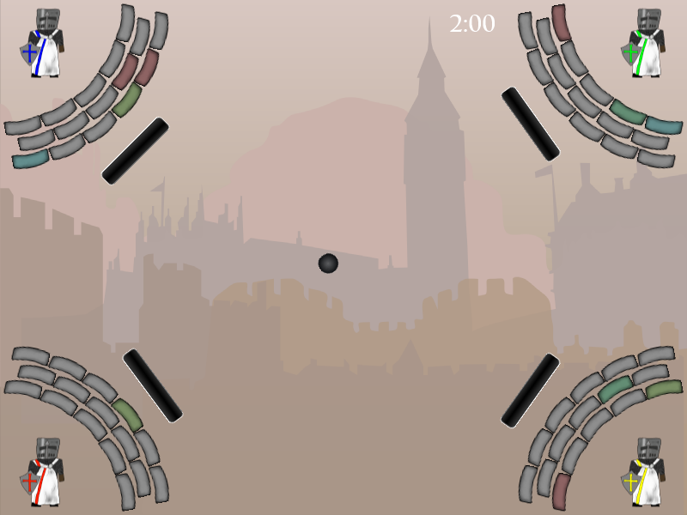
The Game - Neolithic

Slide 6
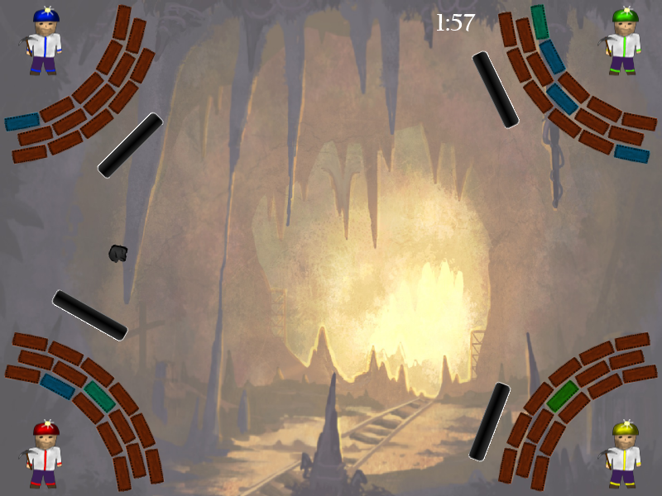
The Game - Neolithic

Slide 7
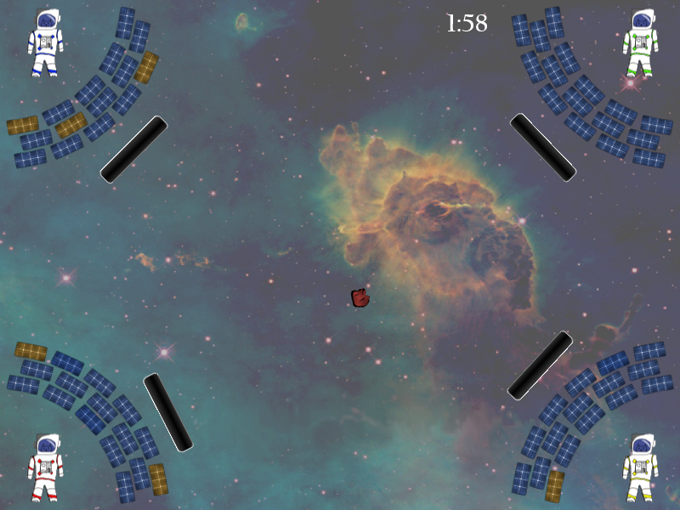
The Game - Neolithic

Slide 8
Special features
Up to four players & AI demo.
Extra balls added throughout the game.
Power-up system affecting balls and paddles.
Balls can be sped up or slowed down
Paddles can be shrunk or grown
Paddles can be sped up or slowed down
Campaign mode with a storyline.
Web based high score board.
Themed background music.

Slide 9
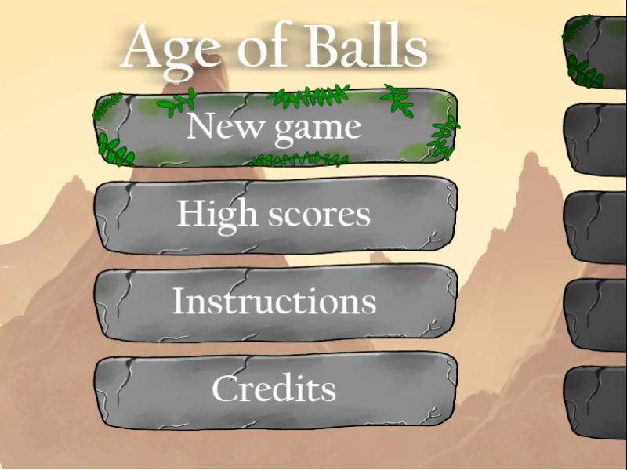

Slide 10
Implementation details
Offline Java 8 game.
Windows, MacOS & Linux.
Uses the JavaFX canvas.
High customisation ability.
Follows the MVC framework and OO principals.
Easy future modifications.

Slide 11
Future improvements
Less glitchy collision detection.
More themed ages.
Increasing difficulty with each age.
Online multiplayer.

